Slide 1
About Me
Oracle Certified Database Administrator
Sun Certified Java Programmer
Certified Ethical Hacker

Slide 2
Django Admin Interface:
Django provides a built-in admin module which can be used to perform CRUD operations on the models. It reads metadata from the model to provide a quick interface where the user can manage the content of the application.
This is a built-in module and designed to perform admin related tasks to the user.
Let's see how to activate and use Django's admin module (interface).

Slide 3
Django Admin Interface Continue ..:
The admin app (django.contrib.admin) is enabled by default and already added into INSTALLED_APPS section of the settings file.
To access it at browser use '/admin/' at a local machine like localhost:8000/admin/ and it shows the following output:

Slide 4
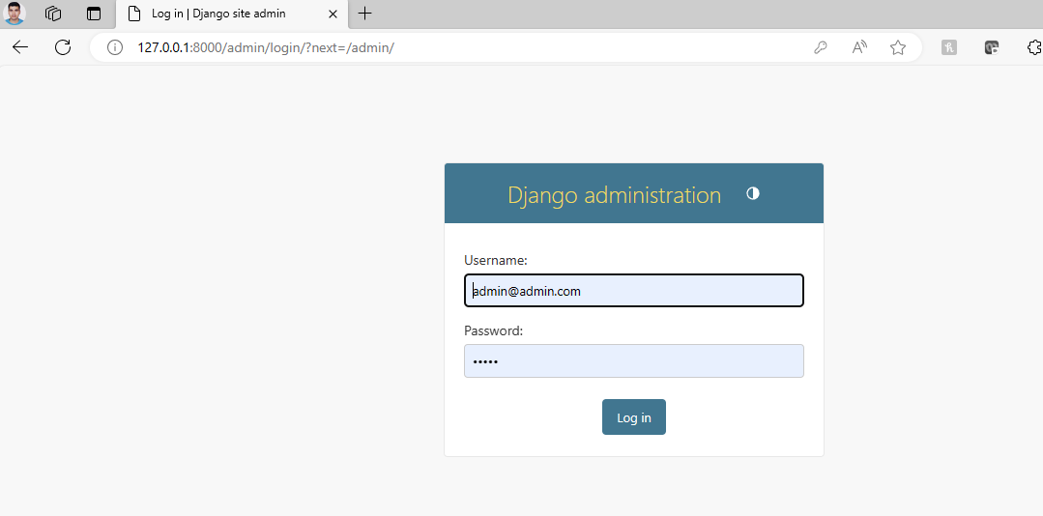
Django Admin Interface Continue ..

Slide 5
Django Admin Interface Continue ..
It prompts for login credentials if no password is created yet, use the following command to create a user.
python manage.py migrate
Create an Admin User
python managen.py createsuperuser

Slide 6
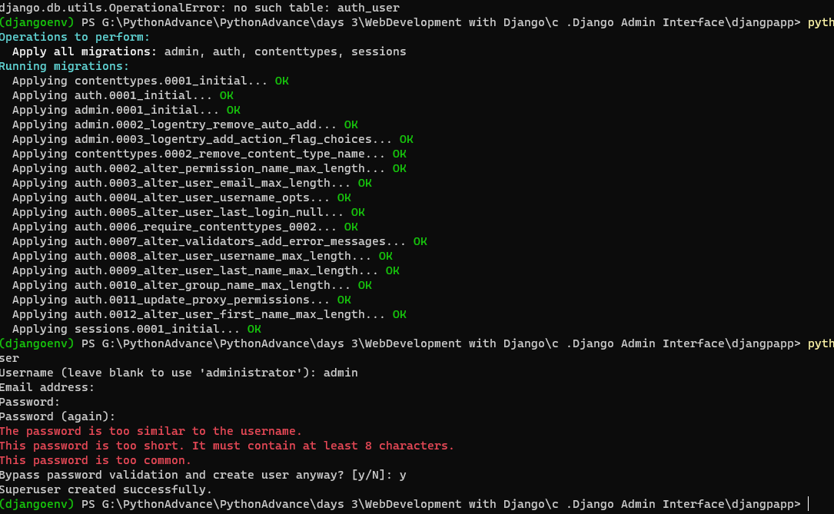
Django Admin Interface Continue ..

Slide 7
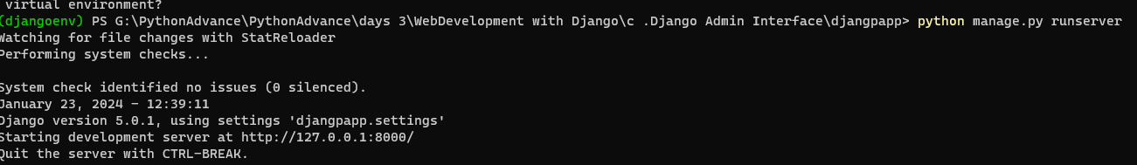
Django Admin Interface Continue ..
Now start development server and access admin login.
python manage.py runserver

Slide 8
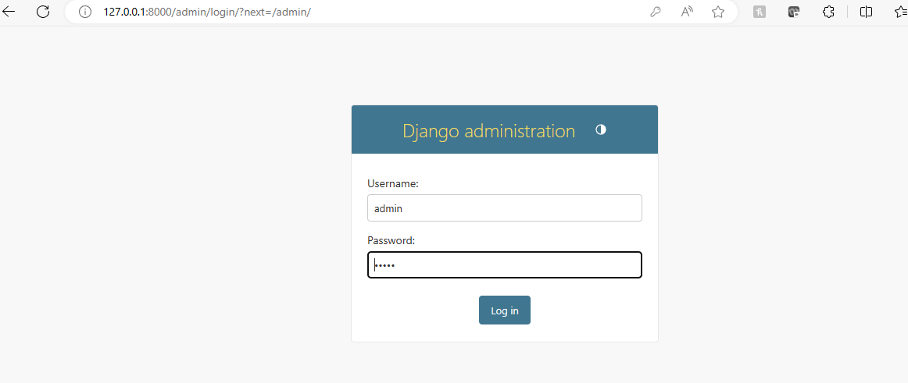
Django Admin Interface Continue ..

Slide 9
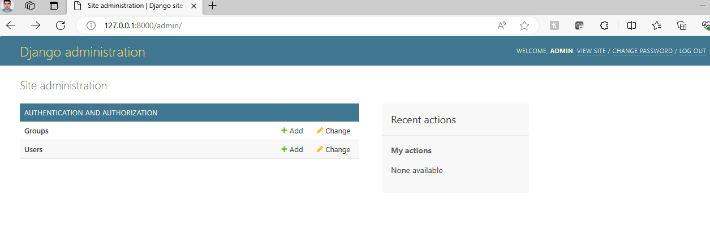
Django Admin Interface Continue ..
After login successfully, it shows the following interface.

Slide 10
Django Admin Interface Continue ..
It is a Django Admin Dashboard. Here, we can add and update the registered models. The model registration process will be discussed in further chapters.

